Slide 1
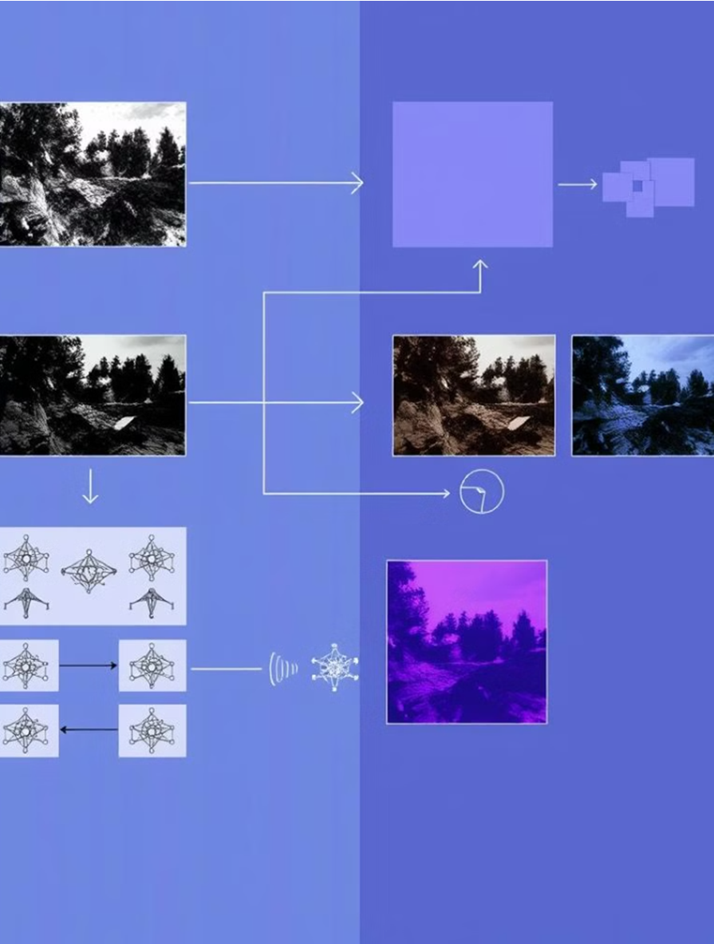


Image Denoising using Noise2Noise with ResNet-50
Omer Ben Shimol
Amit Vinograd
Supervisor: Prof. Zeev Volkovich

Slide 2
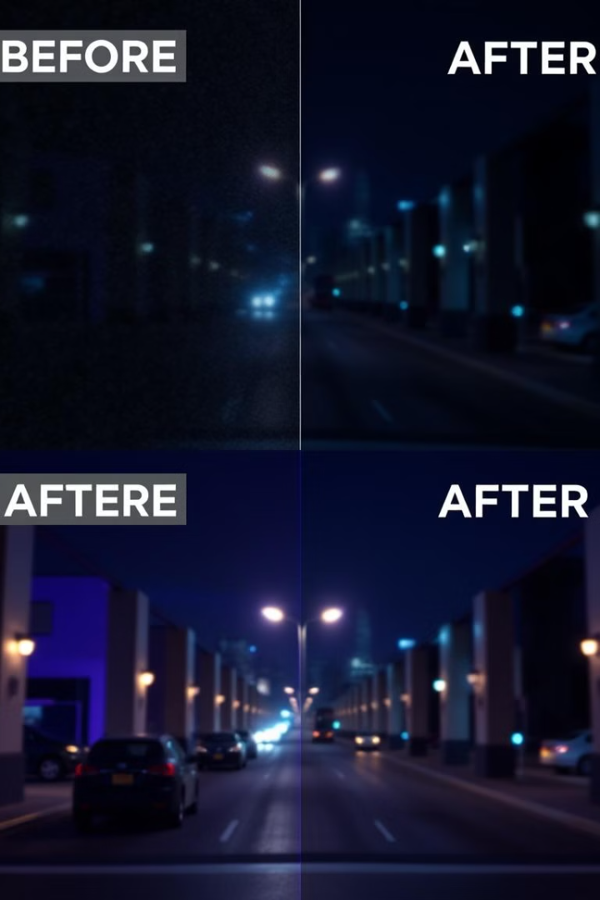
Introduction to Image Denoising
1
Traditional Methods
Rely on prior knowledge of noise distribution or clean image examples
2
Noise2Noise Innovation
Learns to denoise without clean data, using pairs of independently generated noisy images
3
ResNet-50 Integration
Enhances U-Net in the Noise2Noise by leveraging deep residual learning
capabilities

Slide 3
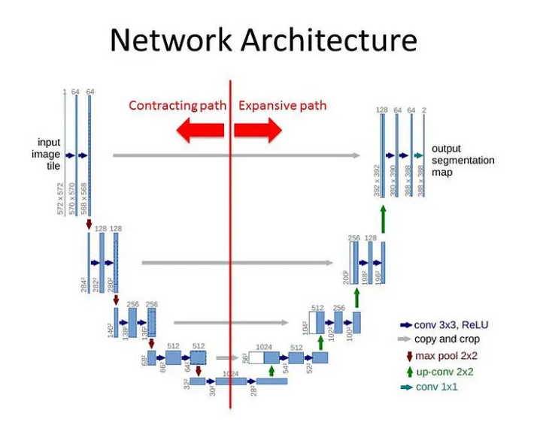
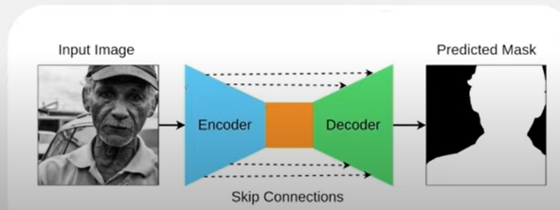
U-net
A convolutional neural network architecture originally designed for image segmentation.
Composed of an encoder (for feature extraction) and a decoder (for image reconstruction).

Slide 4
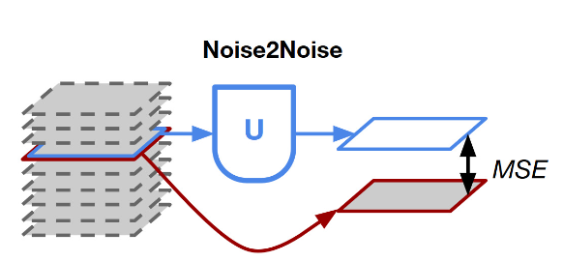
Why Noise2Noise Works
Uses pairs of noisy images as input and target, without needing clean images for training.
Random noise gets averaged out over multiple noisy pairs, helping the model focus on the common clean features.
Minimizes the difference between noisy image pairs, allowing the network to learn the underlying clean signal.

Slide 5
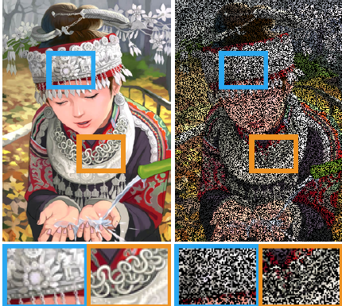
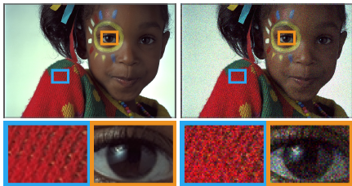
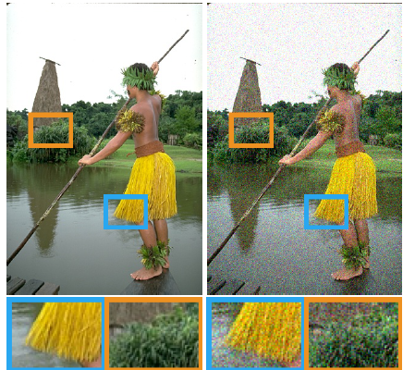
Types of Noise Addressed
Noise2Noise can handle various types of noise, including Bernoulli noise, Poisson noise, additive Gaussian noise. Each type of noise presents unique challenges in image restoration. By utilizing deep learning, Noise2Noise provides an innovative and efficient solution to denoise images across these different noise types.
Bernoulli Noise
Random black pixels, binary noise
Poisson Noise
The image has noise that appears more in darker areas
Additive Gaussian Noise
The image has a smooth, grainy appearance

Slide 6
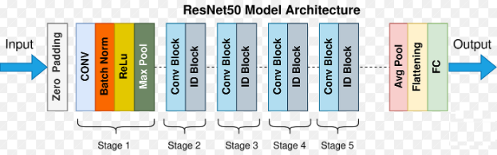
ResNet-50 Architecture
Convolutional Layer
Extracts features from the image using convolutional filters
Mitigates Vanishing Gradient Problem
ReLU helps prevent vanishing gradients by allowing gradients to propagate more effectively during backpropagation.
Batch Norm
Normalize the output of the previous layers
ReLU Function
Turns negative values into zero, introducing non-linearity
Max Pool
Downsamples the features map to reduce the dimensions.

Slide 7
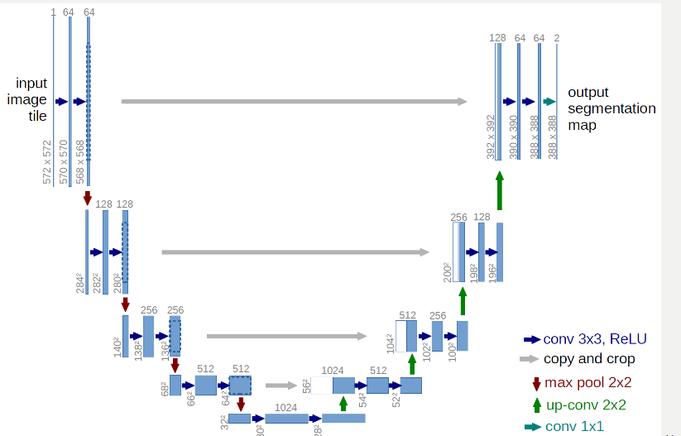
Unet – Resnet50
U-Net
Encoder-Decoder structure
ResNet-50
Deep residual network
Used for image segmentation
Used for image classification
4-5 layers
Exactly 50 layers
Resnet-50 can deal with complex features because of its deep structure and residual connections (skip connections), and that is the reason why it can handle more complex features in images.

Slide 8
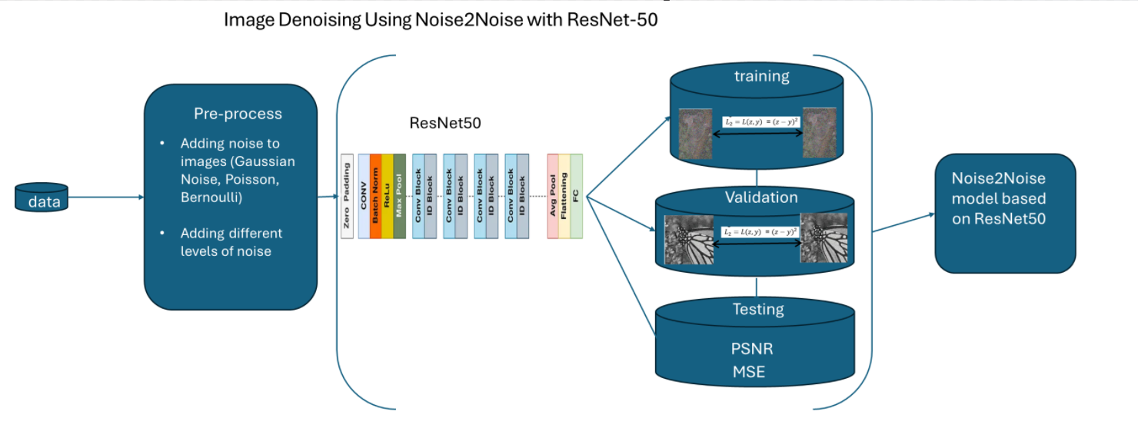
Model Diagrams

Slide 9
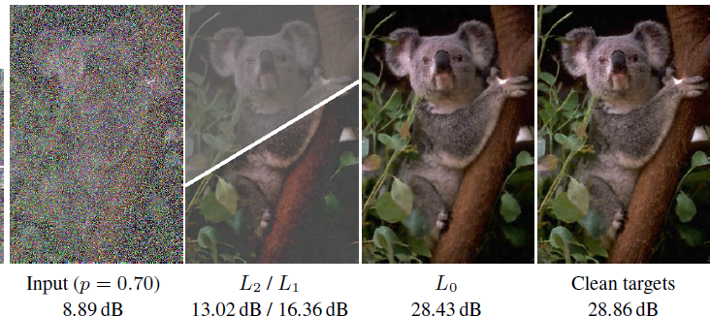

L0 Loss function - (Zero-Norm Loss)
Measures the number of non-zero differences between predicted and true values.
Not commonly used due to its discontinuous nature, making it hard to optimize with gradient-based methods.
Encourages sparsity in the model, often used in feature selection.
The L0 loss function is mathematically represented as $L_{0}=L\left(z,y\right)= ∑1(z≠y)$ where '1' is the indicator function.

Slide 10
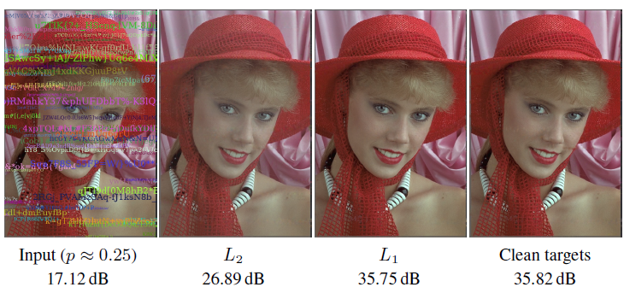

L1 Loss function - (Mean Absolute Error - MAE)
Measures the average absolute differences between predicted and true values.
More robust to outliers compared to L2 loss.
Encourages sparsity in the model weights, making it useful for creating simpler models.
The L1 loss function, represented as $L\left(z,y\right)=|z−y|$

Slide 11
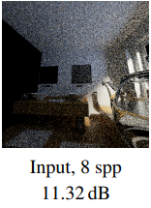
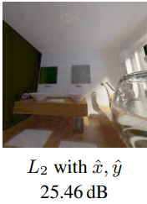

L2 Loss function - (Mean Squared Error – MSE)
Measures the average squared differences between predicted and true values.
Penalizes larger errors more heavily than L1 loss.
Commonly used in regression tasks due to its smooth and continuous nature, making it easier to optimize with gradient-based methods.
The L2 loss function is represented as $L_{2}=L(z,y)$ = ${(z−y)}^{2}$ .

Slide 12
Expected Achievements and Process
The project aims to explore a new Noise2Noise architecture using ResNet-50 instead of the traditional U-Net. We believe ResNet-50 might perform better due to its ability to handle complex image features. The process involves using pairs of noisy images from datasets like SSID to train the model. Hyperparameters will be explored to optimize performance, and loss functions will be used to test the model's accuracy.
1
Compare Performance
Evaluate ResNet-50 against U-Net under the same conditions
2
Optimize Hyperparameters
Explore settings to enhance model performance
3
Test Accuracy
Use loss functions to assess model precision
4
Enhance Denoising Capabilities
Improve performance across various noise types

Slide 13
Model Diagrams
The training process involves feeding preprocessed noisy image pairs to the ResNet-50 model, which learns to map noisy images to cleaner counterparts by minimizing an L2 loss function. During validation, a separate set of noisy image pairs is used to assess the model's generalization. In the testing phase, an independent dataset is used to evaluate the quality of the denoised output using metrics like PSNR and MSE.
1
Training
Process noisy image pairs, update model parameters based on L2 loss
2
Validation
Assess model performance on unseen data without updating weights
3
Testing
Evaluate denoising quality using PSNR and MSE on independent dataset

Slide 14
The training process
Input: During training, the preprocessed noisy image pairs are fed to the ResNet-50 model.
Process: ResNet-50 processes these images, trying to learn how to map noisy images to their cleaner counterparts by minimizing an L2 loss function.
Output: The model updates its parameters (weights) based on the calculated error (using L2 loss) between its output and the expected clean image (which is another noisy image in Noise2Noise).

Slide 15
The validation process
Input: In the validation phase, a separate set of noisy image pairs (not seen during training) is fed into the already trained ResNet-50 model.
Process: The model processes these images just like in training but without updating the model weights. Instead, the model's performance is assessed by calculating the L2 loss on the validation set.
Output: The output from ResNet-50 is compared against the validation targets (again noisy images), and the L2 loss is used to measure how well the model is generalizing to new data.

Slide 16
The testing process
Input: In the testing phase, a completely independent dataset is used. These images are processed by the trained ResNet-50 model.
Process: The model processes these test images, and the quality of the denoised output is evaluated.
Output: The performance is measured using metrics like PSNR (Peak Signal-to-Noise Ratio) and MSE (Mean Squared Error), which indicate how well the model has learned to denoise images.

Slide 17
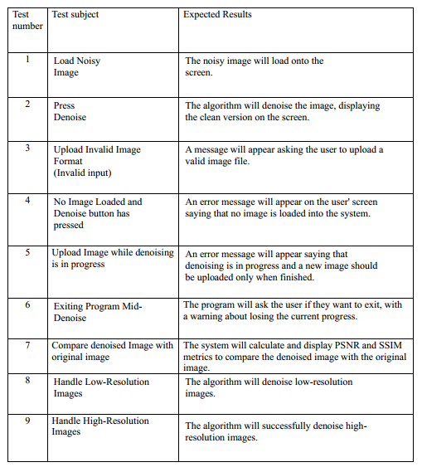

Testing Plan

